Slide 1
Regions, Page Table

Slide 2
Region
A contiguous area of the virtual address space of a process
Can be treated as a distinct object to be shared or protected.
Text, data, and stack usually form separate regions of a process.
Processes can share a region
Share one copy of the text region
Cooperate to share a common shared-memory region
Private per process region table, called a pregion
May exist in the process table, the u area, or in a separately allocated area of memory

Slide 3
Region
pregion
points to a region table entry and contains the starting virtual address of the region in the process
Shared regions may have different virtual addresses in each process
A permission field that indicates the type of access allowed the process
read-only, read-write, or read-execute

Slide 4
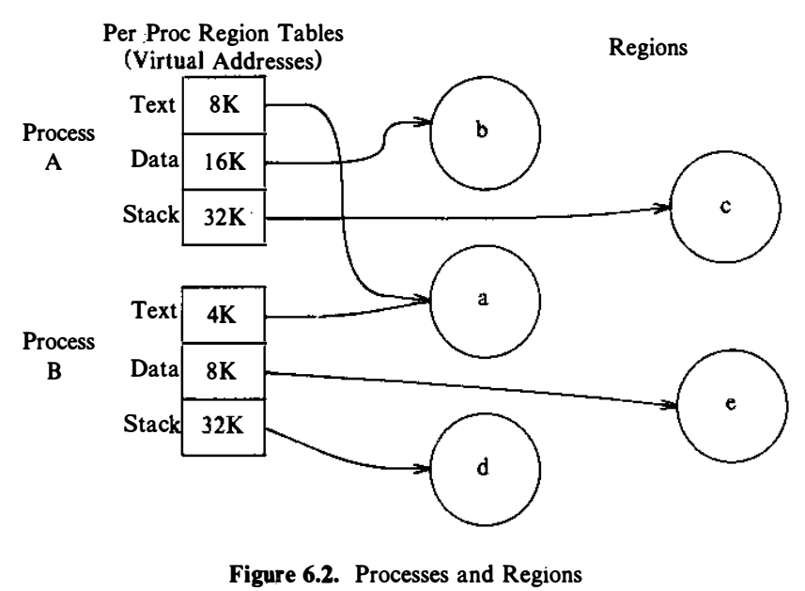
Region

Slide 5
Region
The concept of the region is independent of the memory management policies implemented by the operating system

Slide 6
Pages and Page Tables
The memory management hardware divides physical memory into a set of equal-sized blocks, pages
Page sizes range from 512 bytes to 4K bytes
Every memory location can be addressed by a
(page number, byte offset in page)
If a machine has 2³² bytes of physical memory and a page size of lK bytes,
It has 2²² pages of physical memory;
every 32-bit address can be treated as a pair consisting of a 22-bit page number and a 10-bit offset into the page

Slide 7
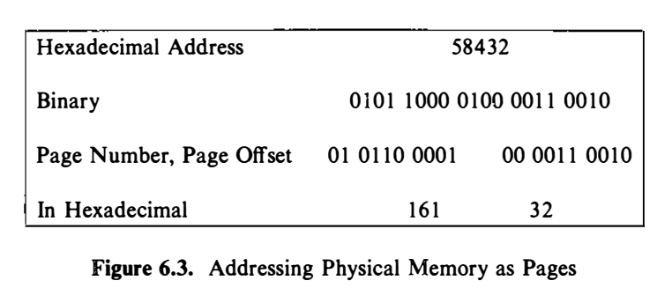
Pages and Page Tables
The purpose of paged memory is to allow greater flexibility in assigning physical memory
Just as the kernel assigns blocks to a file to increase flexibility and to reduce the amount of unused space caused by block fragmentation, so it assigns pages of memory to a region.

Slide 8
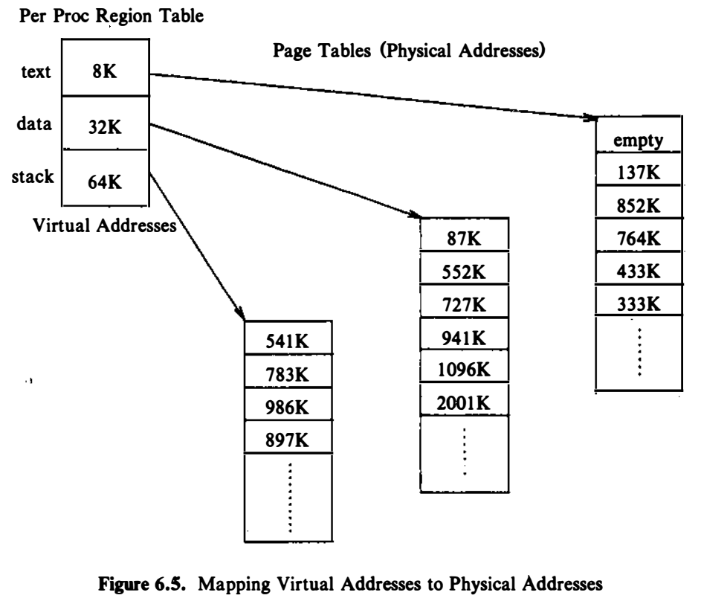
Pages and Page Tables
Assume that the size of a page is l K bytes, and suppose the process wants to access virtual memory address 68,432
The pregion entries show that the virtual address is in the stack region starting at virtual address 64K (65,536 in decimal) , assuming the direction of stack growth is towards higher addresses.
Subtracting, address 68,432 is at byte offset 2896 in the region. Since each page consists of 1K bytes, the address is contained at byte offset 8 4 8 in page 2 (counting from 0) of the region, located at physical address 986K.

Slide 9
Reference
The Design of the UNIX Operating System, by Maurice J. Bach

